Slide 1
User Interface Design
用户界面设计
主讲教师：张钢
Blog: http://blog.sina.com.cn/tjugzhang Email: gzhang@tju.edu.cn
2012年

Slide 2
The process of interaction design
交互设计过程

Slide 3
Lifecycle models
Show how activities are related to each other
Lifecycle models are:
  management tools
  simplified versions of reality
Many lifecycle models exist, for example:
  from software engineering: waterfall, spiral, JAD/RAD, Microsoft, agile
  from HCI: Star, usability engineering

Slide 4
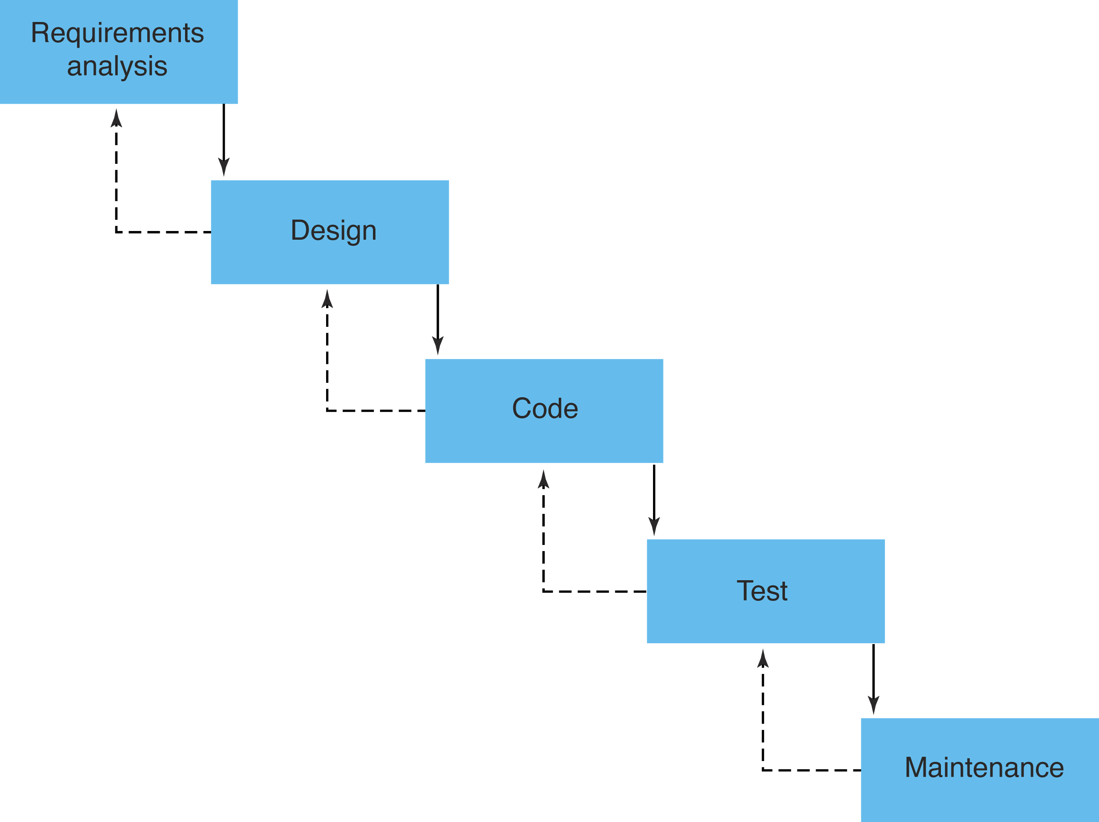
Traditional ‘waterfall’ lifecycle

Slide 5
The Star lifecycle model
Suggested by Hartson and Hix (1989)
Important features:
  Evaluation at the center of activities
  No particular ordering of activities; development may start in any one
  Derived from empirical studies of interface designers

Slide 6
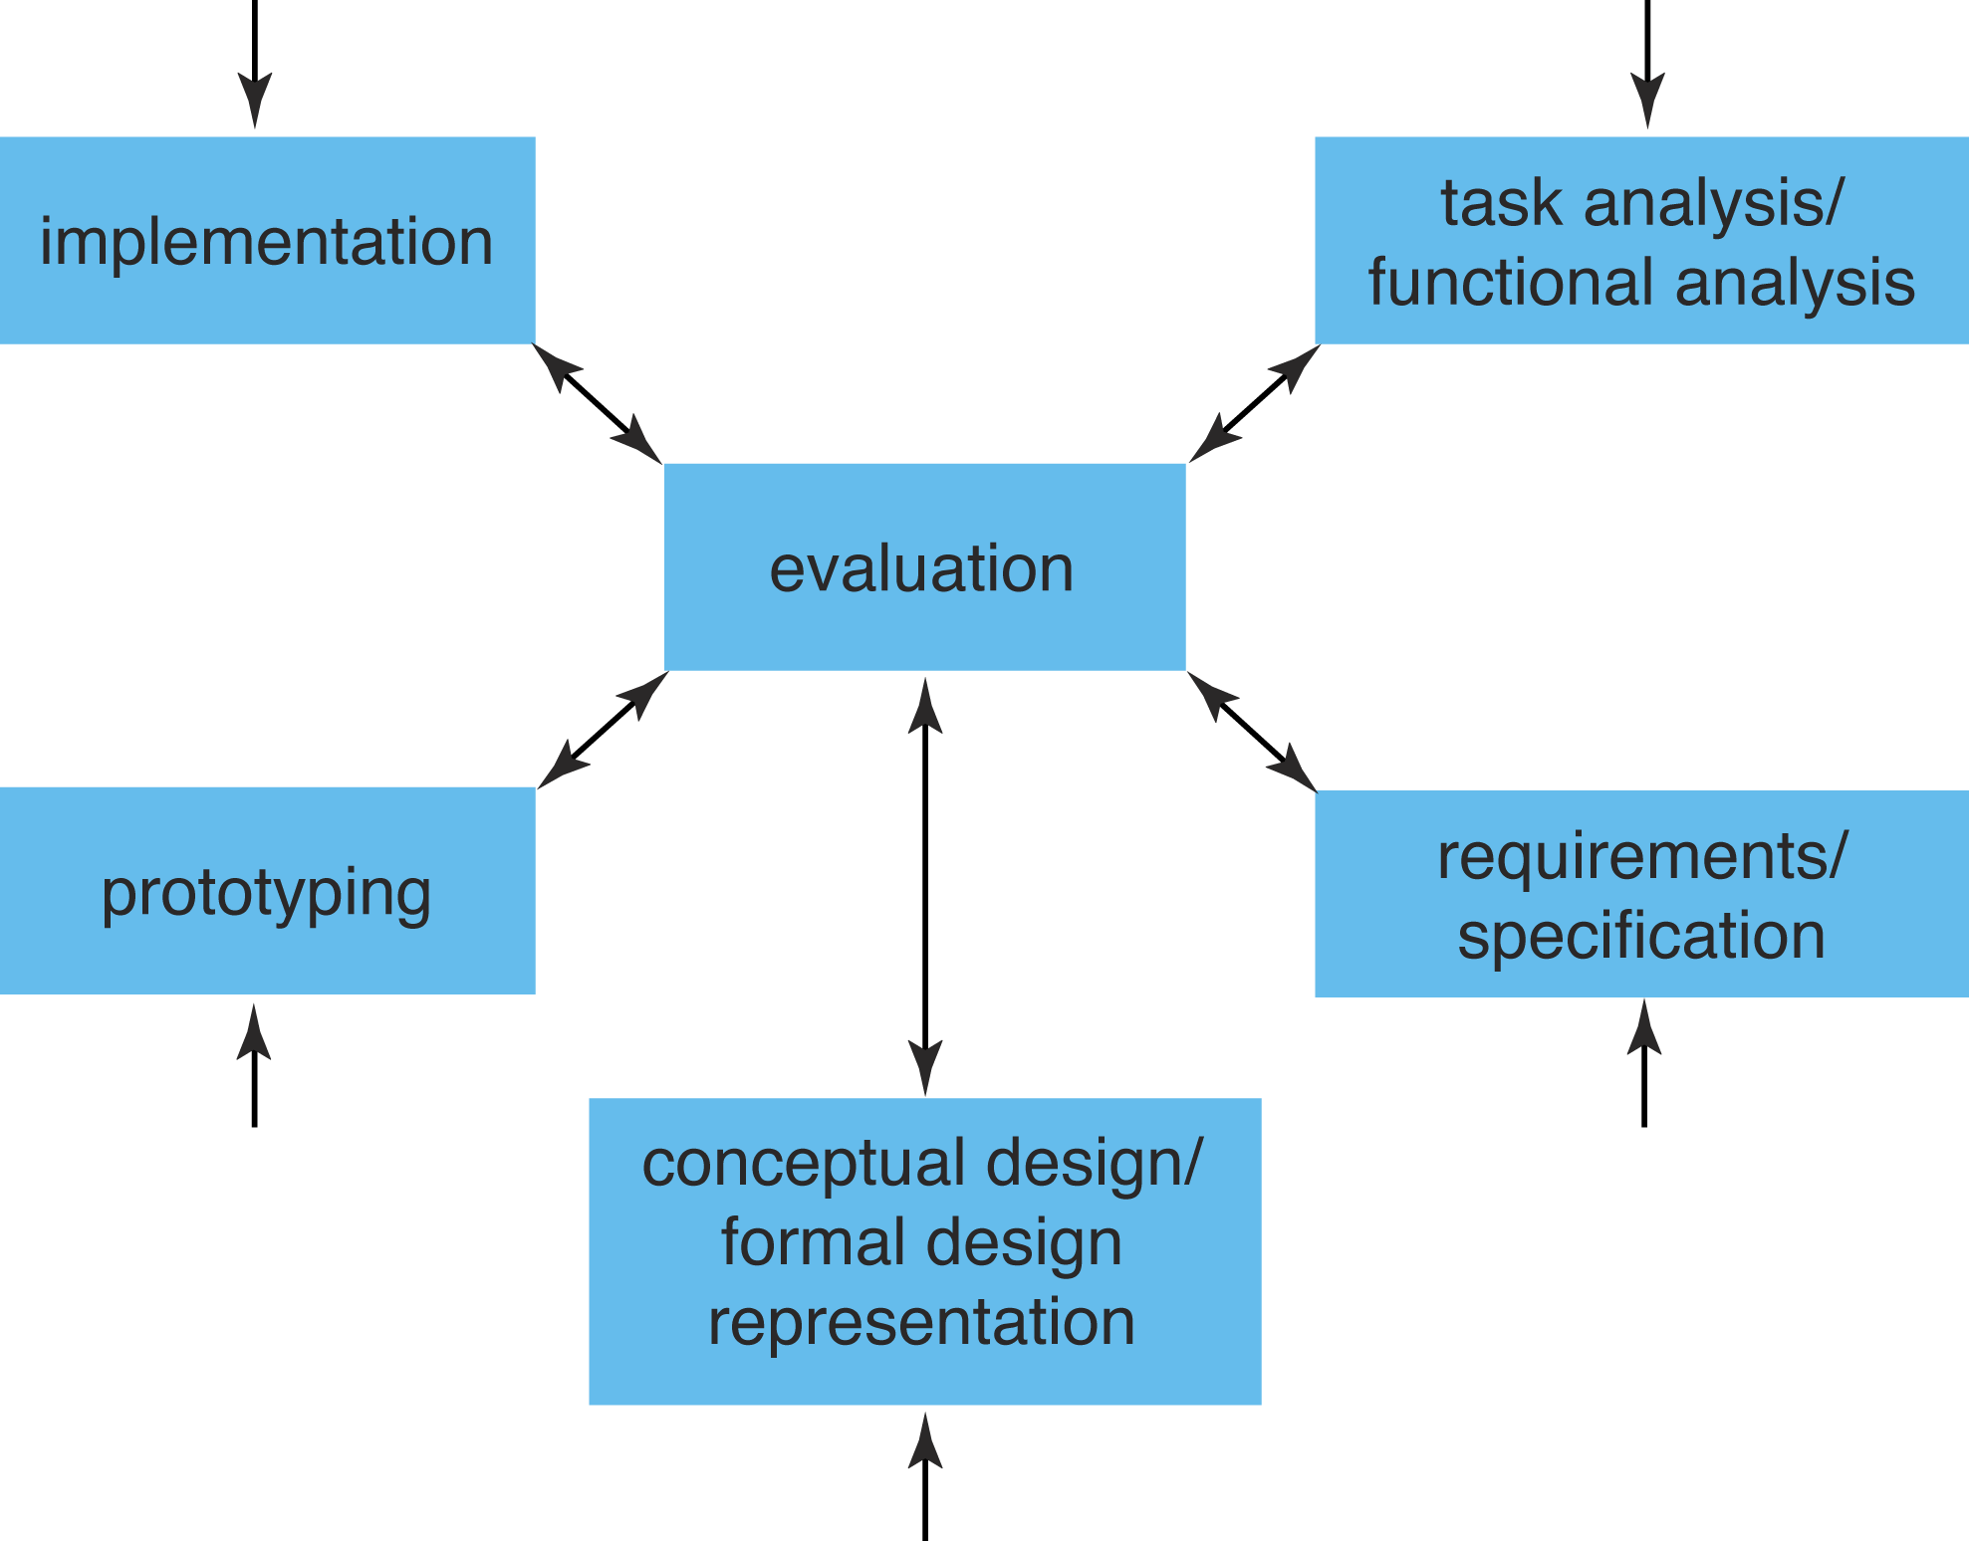
The Star Model (Hartson and Hix, 1989)
Notes:
UCD is a very general philosophy that instantiates itself in the context of a design project. Within HCI there have been many attempts to come up with actual life cycles where users are central. Examples include Rubinstein and Hersch successive iteration of 5 stages, info collection, design, implementation, evaluation and deploment. The one here is taken from Hartson and Hix
model came about by analysing how design takes place in practice
evaluation is central: results of each activity are evaluated before going onto next one
both bottom-up and top -down required in waves
software designers are familiar with this in their work and call it ‘yo-yoing’
it is important to do both structure and detail at the same time
in practice this is what is done - but the end result suggests otherwise corporate requirements dictate a top=down approach which is what gets recorded
ch 5 of Developing User Interfaces (An Overview of Systems Analysis and Design) p- nice step-by-step methodology for doing user-centred design

Slide 7
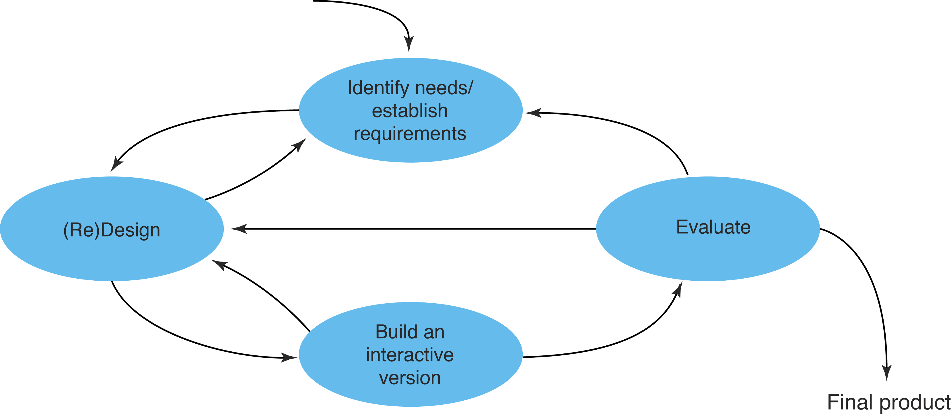
A simple interaction design model
简单交互设计模型
识别需要
建立需求
(再)设计
评价
建立交互版本
最终产品
Exemplifies a user-centered design approach

Slide 8
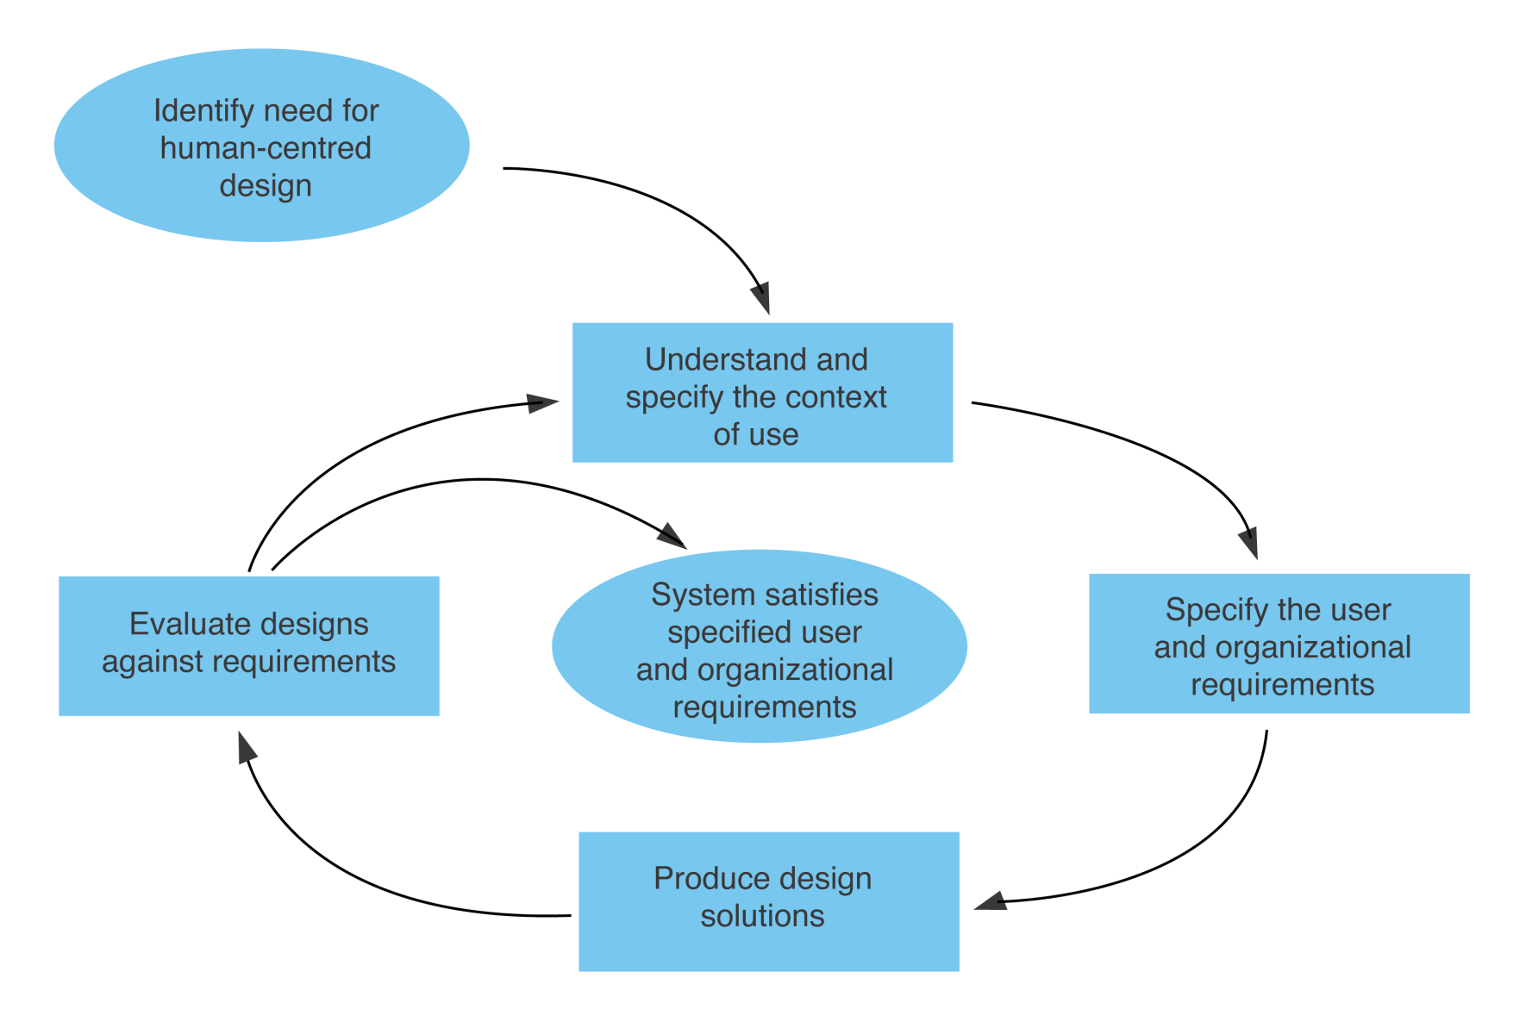
ISO 13407: Human Centred Design Process for Interactive Systems
为以人为中心设计识别需求
理解和说明使用环境
根据需求
评价设计
说明用户和组织需求
系统满足需求
产生设计解决方案
The interdependence of human-centred design activities

Slide 9
ISO 13407: Human Centred Design Process for Interactive Systems
Interactive System
  Combination of hardware and software components that receive input from, and communicate output to, a human user in order to support his or her performance of a task
Prototype
  Representation of all or part of a product or system that, although limited in some way, can be used for evaluation

Slide 10
ISO 13407: Human Centred Design Process for Interactive Systems
Usability
  Extent to which a product can be used by specified users to achieve specified goals with effectiveness, efficiency and satisfaction in a specified context of use
Effectiveness
  Accuracy and completeness with which users achieve specified goals
Efficiency
  Resources expended in relation to the accuracy and completeness with which users achieve goals

Slide 11
ISO 13407: Human Centred Design Process for Interactive Systems
Satisfaction
  Freedom from discomfort, and positive attitudes to the use of the product
Context of use
  Users, tasks, equipment (hardware, software and materials), and the physical and social environments in which a product is used
User
  Individual interacting with the system

Slide 12
作业
阅读文献
The Standard of User-Centered Design and the Standard Definition of Usability - Analyzing ISO 13407 against ISO 9241-11
提交阅读报告

Slide 13
What is involved in Interaction Design?
交互设计中涉及到什么?
It is a process 是一个过程
  a goal-directed problem solving activity informed by intended use, target domain, materials, cost, and feasibility
  a creative activity
  a decision-making activity to balance trade-offs
It is a representation 是一种描述
  a plan for development
  a set of alternatives and successive elaborations

Slide 14
Degrees of user involvement
用户参与度
Member of the design team
  Full time: constant input, but lose touch with users
  Part time: patchy input, and very stressful
  Short term: inconsistent across project life
  Long term: consistent, but lose touch with users
Newsletters and other dissemination devices
  Reach wider selection of users
  Need communication both ways
Combination of these approaches

Slide 15
What is a user-centered approach?
什么是用户中心方法?
User-centered approach is based on:
  Early focus on users and tasks: 提早关注用户和任务
    directly studying cognitive, behavioral, anthropomorphic & attitudinal characteristics
  Empirical measurement: 实证测量
    users’ reactions and performance to scenarios, manuals, simulations & prototypes are observed, recorded and analysed
  Iterative design: 迭代设计
    when problems are found in user testing, fix them and carry out more tests

Slide 16
Four basic activities
四种基本活动
Four basic activities in Interaction Design:
  1. Identifying needs and establishing requirements
  确定需要和建立需求
  2. Developing alternative designs
  开发可选择的设计
  3. Building interactive versions of the designs
  构建设计的交互版本
  4. Evaluating designs
  评价设计

Slide 17
Some practical issues
一些实际问题
Who are the users?
用户是谁？
What are ‘needs’?
需要是什么？
Where do alternatives come from?
选择方案从哪里来？
How do you choose among alternatives?
你如何在选择方案中选择？

Slide 18
Who are the users/stakeholders?
谁是用户/利益相关者？
Not as obvious as you think: 不像想的那么明显
  those who interact directly with the product与产品直接交互者
  those who manage direct users管理直接用户者
  those who receive output from the product 从产品接收输出者
  those who make the purchasing decision 做购买决定者
  those who use competitor’s products使用竞争对手产品者
Three categories of user (Eason, 1987):
  primary: frequent hands-on经常实际使用产品者
  secondary: occasional or via someone else偶尔或通过其他人使用产品者
  tertiary: affected by its introduction, or will influence its purchase影响或将会影响购买者

Slide 19
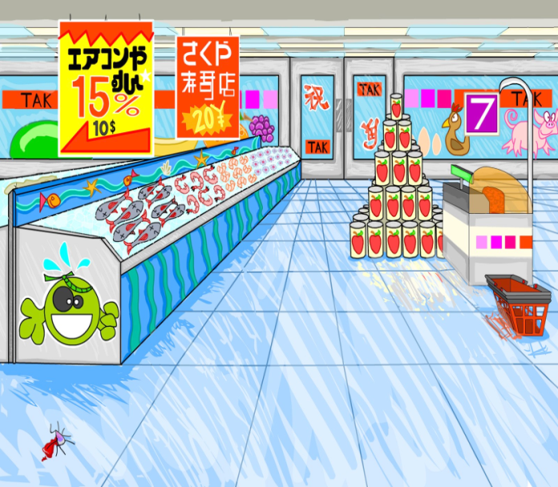
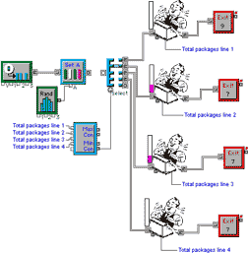
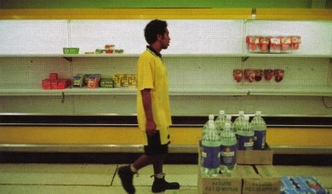
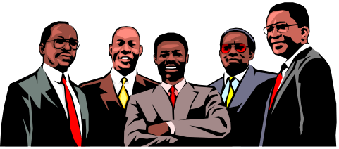
Who are the stakeholders?
谁是利益相关者？
Check-out operators
• Suppliers
• Local shop
owners
Customers
Managers and owners

Slide 20
What are the users’ capabilities?什么是用户的能力?
Humans vary in many dimensions:
  size of hands may affect the size and positioning of input buttons(手的大小)
  motor abilities may affect the suitability of certain input and output devices(运动能力)
  height if designing a physical kiosk(身高)
  strength - a child’s toy requires little strength(力量) to operate, but greater strength to change batteries
  disabilities (e.g. sight, hearing, dexterity灵巧) (残疾)

Slide 21
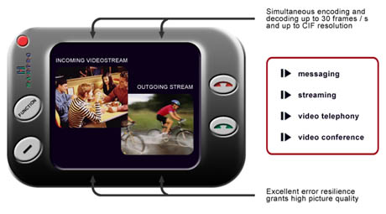
What are ‘needs’?需要是什么?
Users rarely know what is possible
Users can’t tell you what they ‘need’ to help them achieve their goals
Instead, look at existing tasks:
  their context
  what information do they
  require?
  who collaborates to achieve the task?谁合作完成任务
  why is the task achieved the way it is?为什么完成任务的方式是这样
Envisioned tasks:设想的任务
  can be rooted in existing behaviour基于现有的行为
  can be described as future scenarios描述未来的情形

Slide 22
Where do alternatives come from?
可选设计从哪里来
Humans stick to what they know works
But considering alternatives is important to ‘break out of the box’
Designers are trained to consider alternatives, software people generally are not
How do you generate alternatives?如何产生可选设计
  ‘Flair and creativity’: research and synthesis
  ‘天赋和创造性’: 研究与综合
  Seek inspiration: look at similar products or look at very different products
  寻找灵感: 看类似产品或非常不同的产品

Slide 23
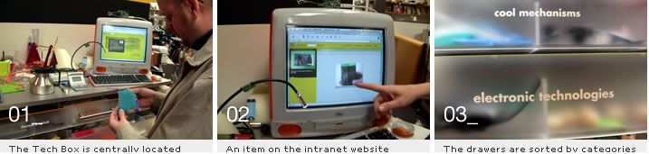
IDEO TechBox
Library, database, website - all-in-one
Contains physical gizmos for inspiration
From: www.ideo.com/

Slide 24
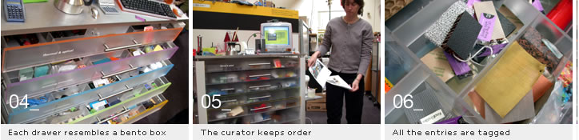
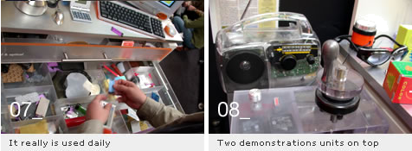
The TechBox

Slide 25
How do you choose among alternatives?
如何作出选择
Evaluation with users or with peers, e.g. prototypes
Technical feasibility: some not possible (技术可行性)
Quality thresholds: Usability goals lead to usability criteria set early on and check regularly (质量标准)
    safety: how safe?
    utility: which functions are superfluous?
    哪些功能多余
    effectiveness: appropriate support? task coverage, information available
    efficiency: performance measurements

Slide 26
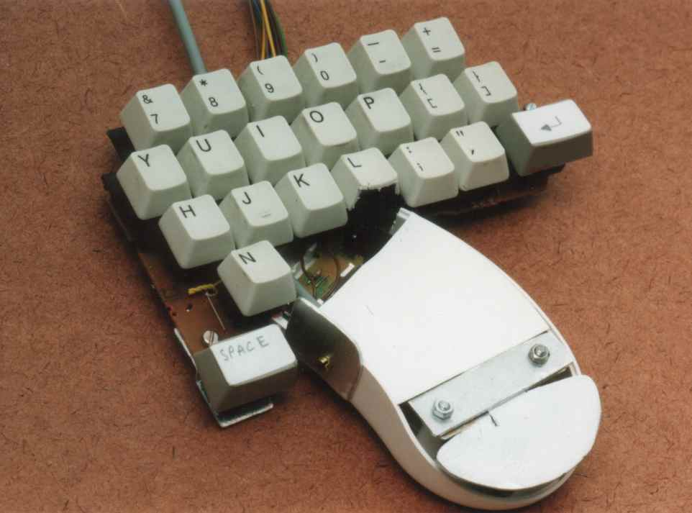
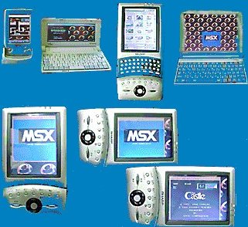
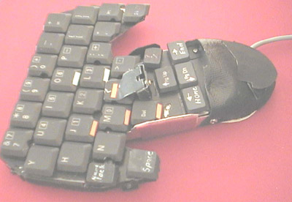
Testing prototypes to choose among alternatives测试原型做出选择

Slide 27
Summary
  Four basic activities in the design process
    Identify needs and establish requirements
    Design potential solutions ((re)-design)
    Choose between alternatives (evaluate)
    Build the artefact
  User-centered design rests on three principles
    Early focus on users and tasks
    Empirical measurement using quantifiable & measurable usability criteria
    Iterative design
  Lifecycle models show how these are related

